Slide 1
CIS CONTROL 9: LIMITATION & CONTROL OF NETWORK
CIS 20 Critical Security Controls

Slide 2
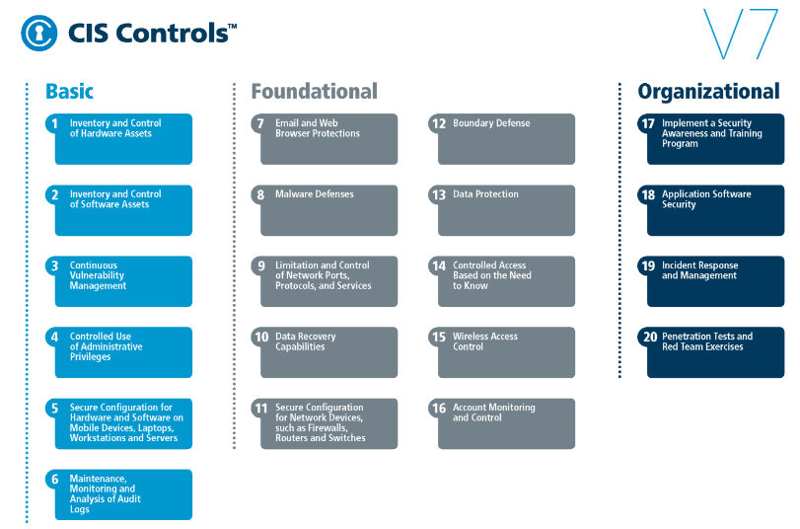
CIS CONTROL 9: LIMITATION & CONTROL OF NETWORK
https://www.cisecurity.org/controls/

Slide 3
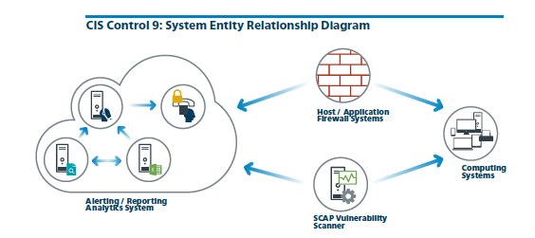
CIS CONTROL 9: LIMITATION & CONTROL OF NETWORK
https://www.cisecurity.org/controls/

Slide 4
CIS CONTROL 9: LIMITATION & CONTROL OF NETWORK
9.1: Associate Active Ports, Services and Protocols to Asset Inventory
Associate active ports, services and protocols to the hardware assets in the asset inventory.

Slide 5
CIS CONTROL 9: LIMITATION & CONTROL OF NETWORK
9.2: Ensure Only Approved Ports, Protocols and Services Are Running
Ensure that only network ports, protocols, and services listening on a system with validated business needs, are running on each system.

Slide 6
CIS CONTROL 9: LIMITATION & CONTROL OF NETWORK
9.3: Perform Regular Automated Port Scans
Perform automated port scans on a regular basis against all systems and alert if unauthorized ports are detected on a system.

Slide 7
CIS CONTROL 9: LIMITATION & CONTROL OF NETWORK
9.4: Apply Host-based Firewalls or Port Filtering
Apply host-based firewalls or port filtering tools on end systems, with a default-deny rule that drops all traffic except those services and ports that are explicitly allowed.

Slide 8
CIS CONTROL 9: LIMITATION & CONTROL OF NETWORK
9.5: Implement Application Firewalls
Place application firewalls in front of any critical servers to verify and validate the traffic going to the server. Any unauthorized traffic should be blocked and logged.

Slide 9
CIS CONTROL 9: LIMITATION & CONTROL OF NETWORK
PROCEDURES & TOOLS:
Port scanning tools are used to determine which services are listening on the network for a range of target systems. In addition to determining which ports are open, effective port scanners can be configured to identify the version of the protocol and service

Slide 10
CIS CONTROL 9: LIMITATION & CONTROL OF NETWORK
…listening on each discovered port. This list of services and their versions are compared against an inventory of services required by the organization for each server and workstation in an asset management system.

Slide 11
CIS CONTROL 9: LIMITATION & CONTROL OF NETWORK
Recently added features in these port scanners are being used to determine the changes in services offered by scanned machines on the network since the previous scan, helping security personnel identify differences over time.
END

